Slide 1


CarePluse
Connecting Patients with Hospitals in Emergencies
1MS23IS077
1MS23IS085
1MS23IS103
1MS23IS121
Nikhil S Bhat
Paridhi Khemka
Ronnie Thomson
Srihari K
voISE Hackathon 2025

Slide 2

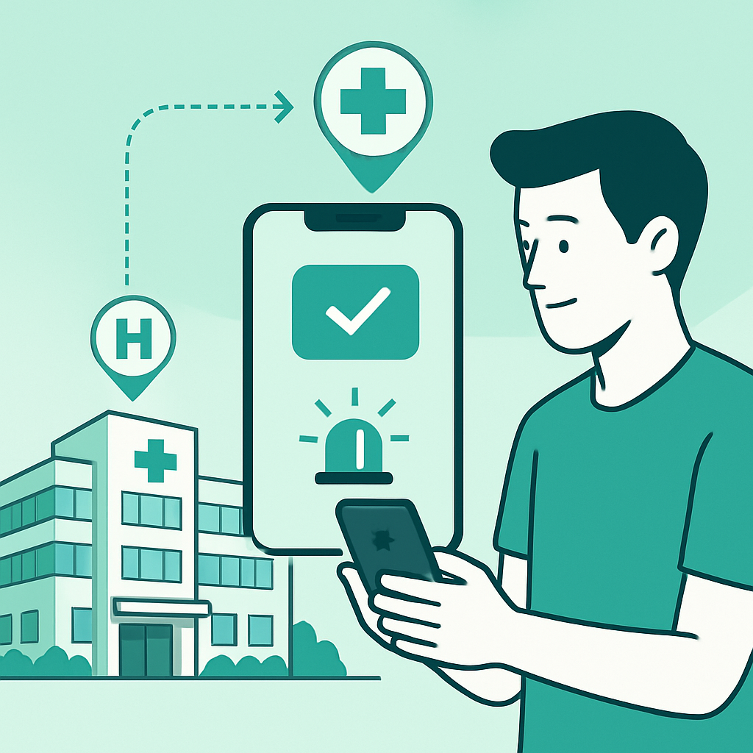
Introduction to the Problem Statement
Patients in emergency situations often lack real-time information about hospital capabilities and availability, leading to delays in receiving appropriate care. When they arrive at a hospital, they may discover that the facility cannot treat their specific condition, resulting in wasted time, increased risk, and potential deterioration of their health.
voISE Hackathon 2025

Slide 3
Our Objective
Create a real-time platform that instantly give the patients real time information about the appropriate hospital.
Automatic patient prioritization based on severity.
Provide hospitals real-time patient info and request management.
Improve response time and patient outcomes.
Optimize hospital resource allocation.
Ensure accessibility for all user groups

Slide 4
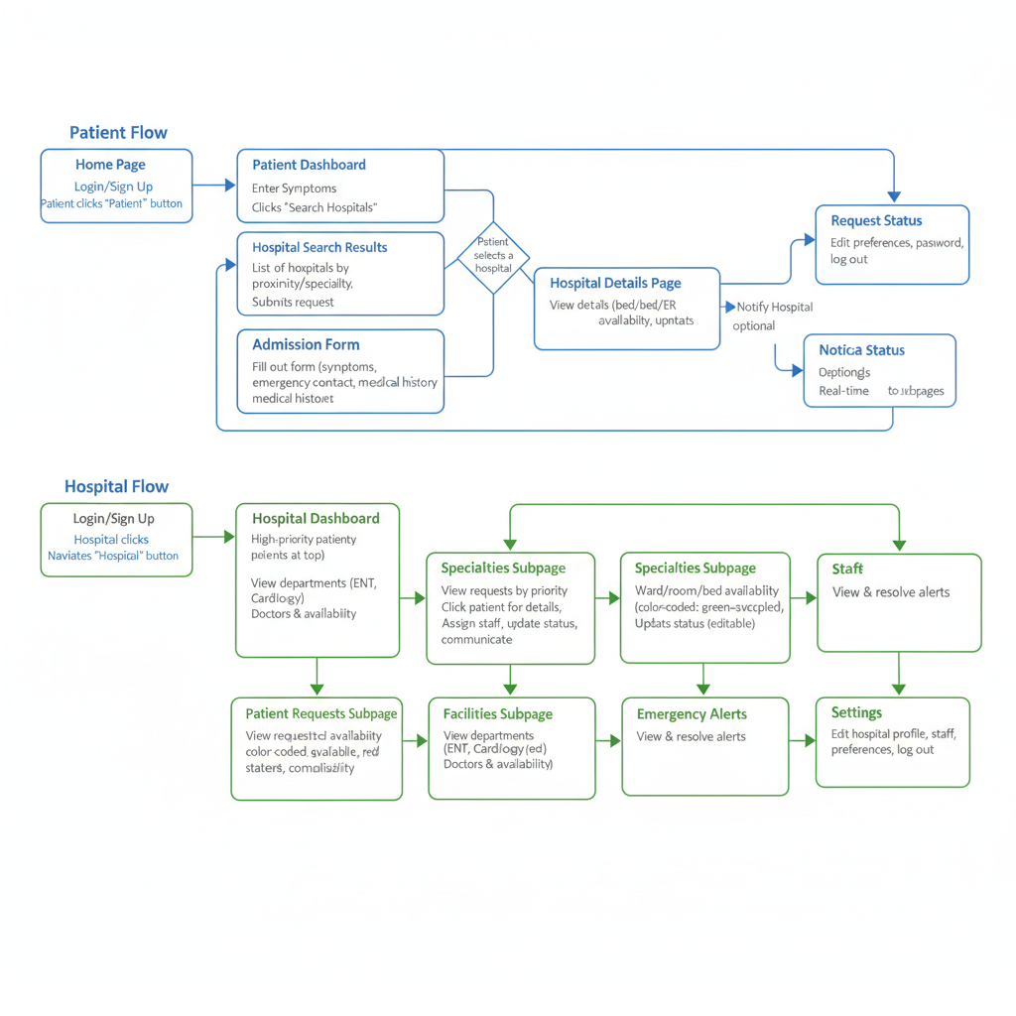

Slide 5
Live Demo

Slide 6

Future Advancements
Seamless integration with IoT devices and wearables for real-time health monitoring
Enhanced interoperability with hospital systems, EHRs, and ambulance dispatch platforms
Advanced voice-enabled and accessibility features for all user groups
Cloud-based scalability and real-time analytics for performance tracking and reporting
voISE Hackathon 2025

Slide 7
THANK YOU
voISE Hackathon 2025
May 2025

